Slide 1
Theory of Automata (CSC- 402) Semester : Spring 2026 Credit Hours: 3

Slide 2
Theory of Automata Course
Lecture 6

Slide 3
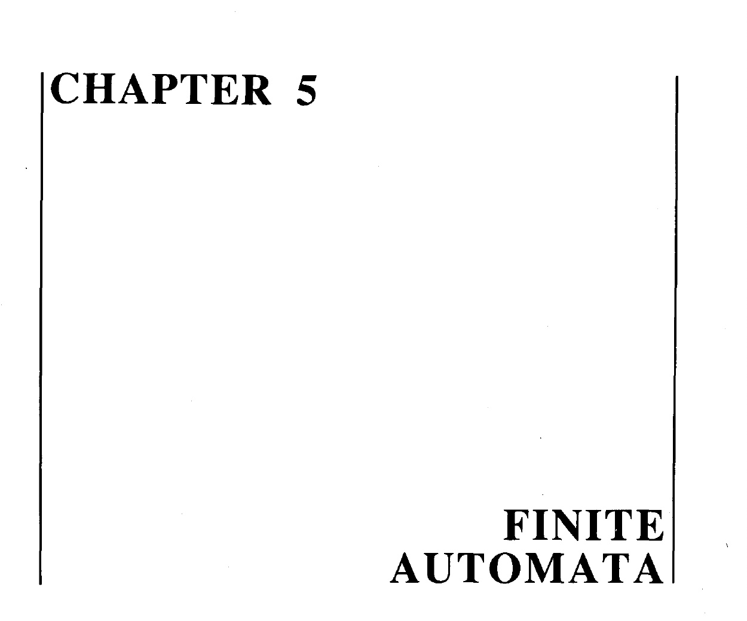

Slide 4
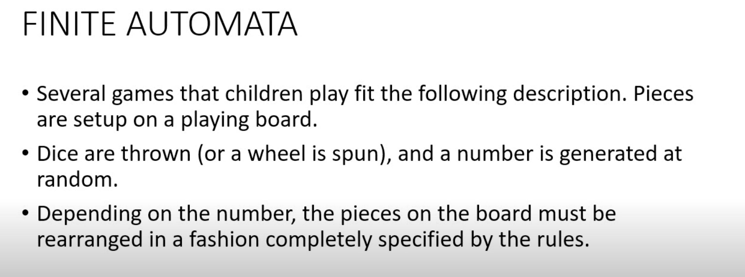

Slide 5
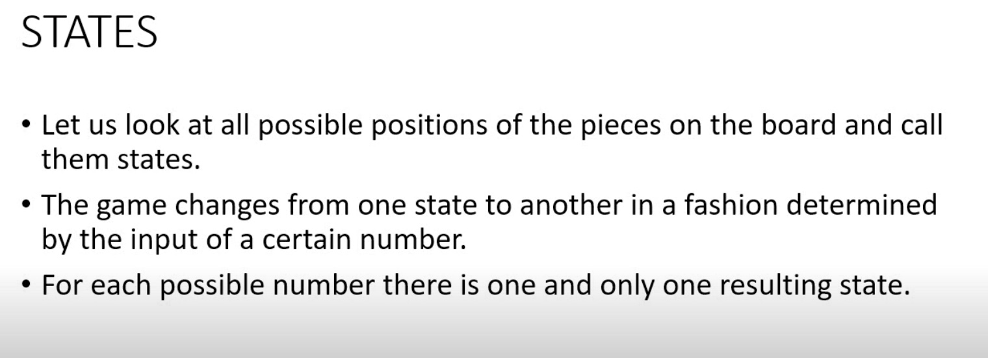

Slide 6


Slide 7
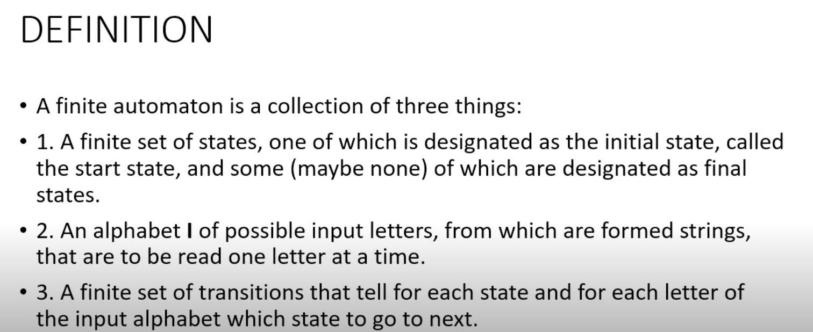

Slide 8


Slide 9


Slide 10
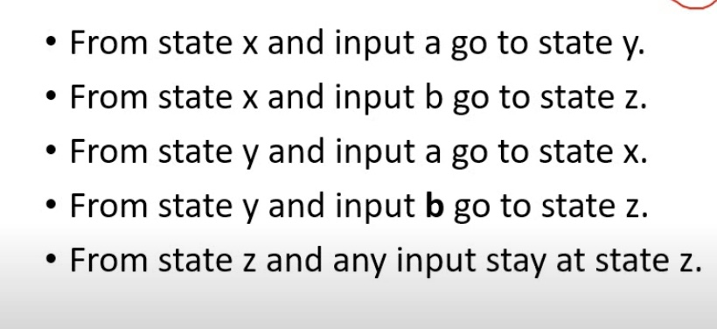
Rules

Slide 11
How to create its machine ?

Slide 12
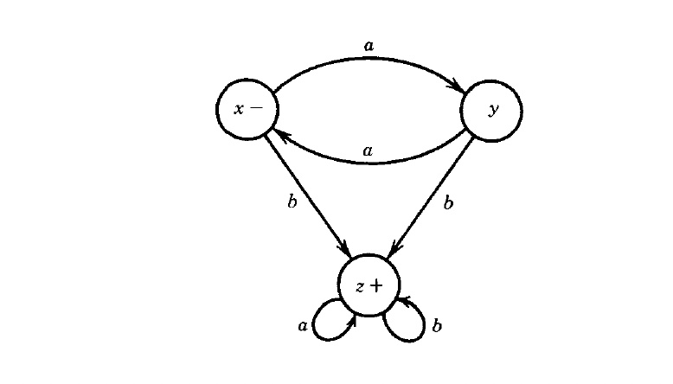
State Diagram

Slide 13
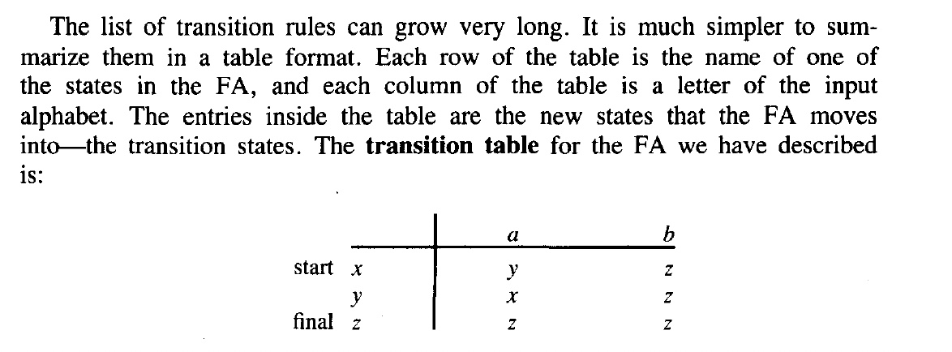
Transition Table

Slide 14
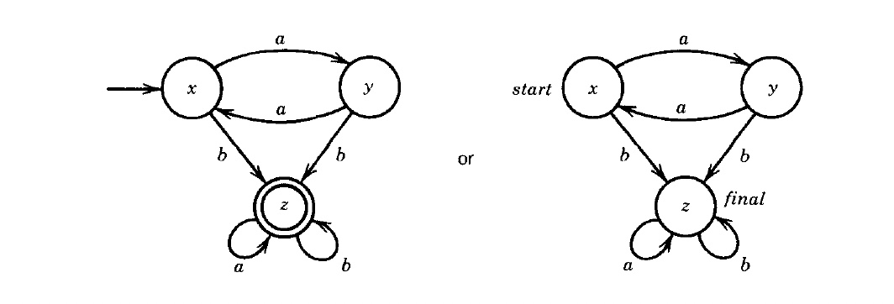

Slide 15
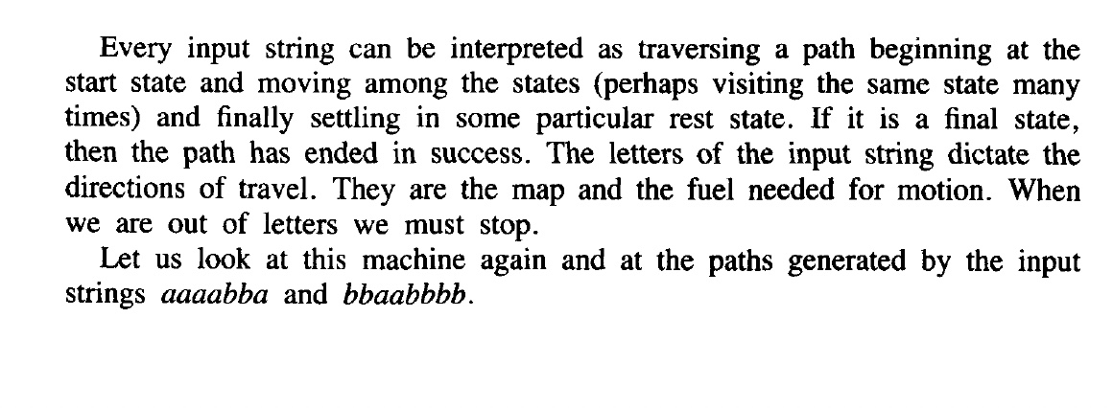
Checking of strings

Slide 16
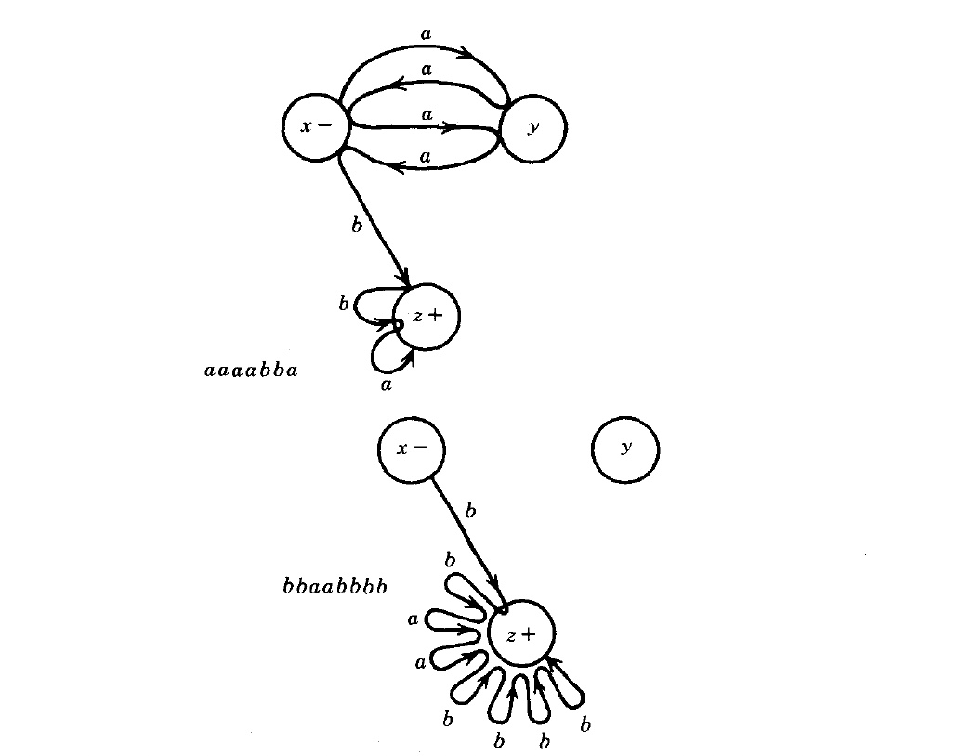
Working - Path

Slide 17


Slide 18
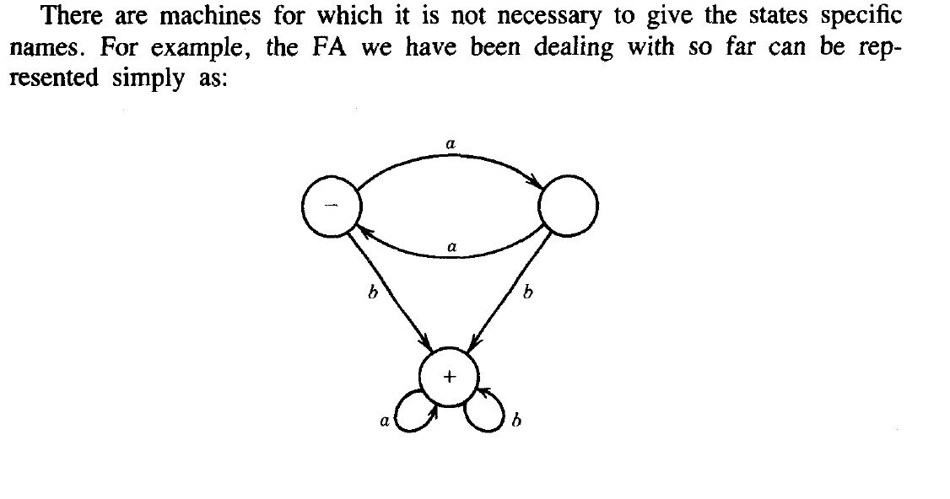
Without state name

Slide 19

Explaination of previous slide

Slide 20



Slide 21
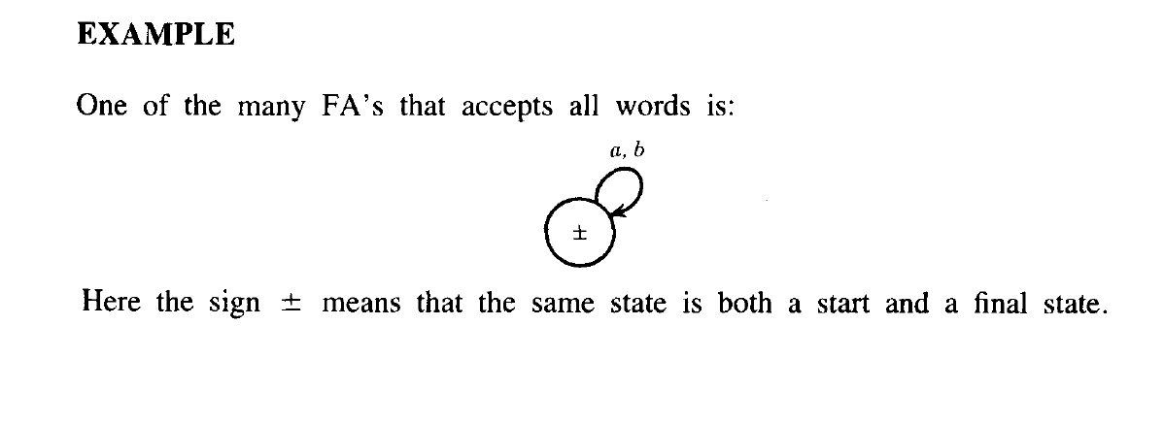


Slide 22
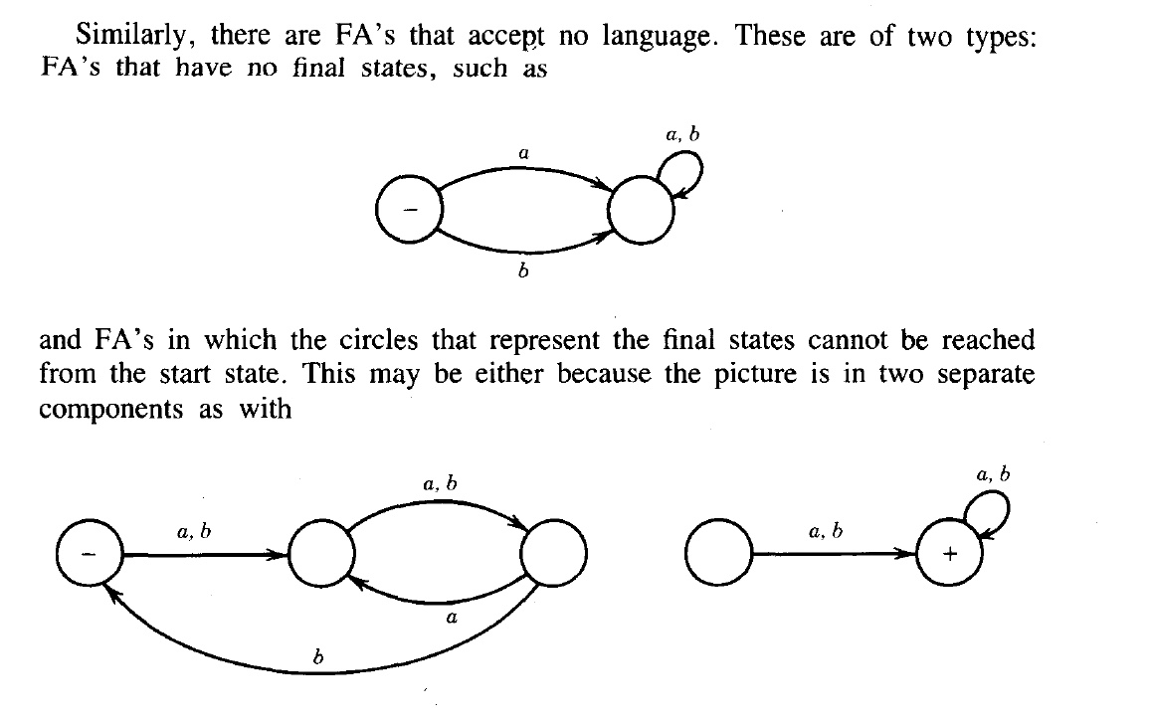
Disconnected Graph

Slide 23
End of Lecture

